Slide 1
Smart Home
CSE316 Project Proposal
1805046 - Al Amru Bil Maruf
1805047 - A.K.M. Ashfaqur Rahman
1805052 - Hasan Masum
1805057 - Md. Jehadul Karim

Slide 2

FEATURES
Sensor-controlled Switches
Temperature & Humidity Measurement
Automated Door Control
Fire & Gas Leak Alert
Theft Protection & Alert
Smartphone Connectivity

Slide 3
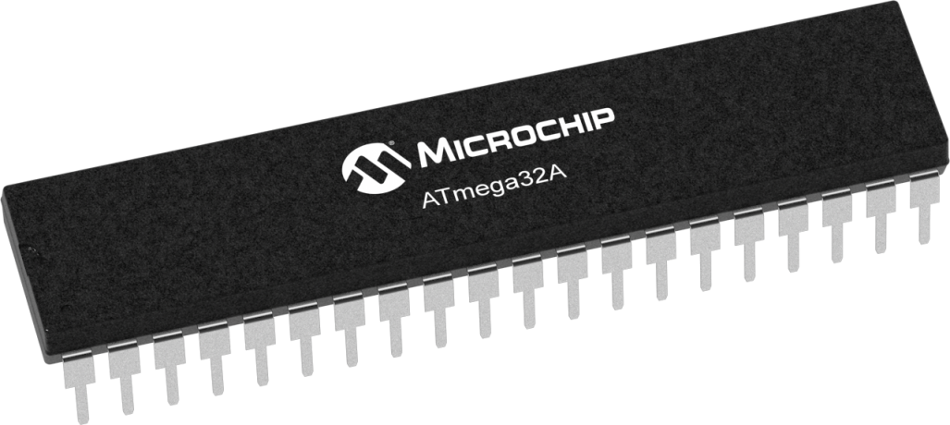
Microcontroller
ATMega32a
Arduino Uno*
*We wish to minimize our microcontroller use. If ATMega32a appears enough, we will refrain from using Arduino Uno

Slide 4
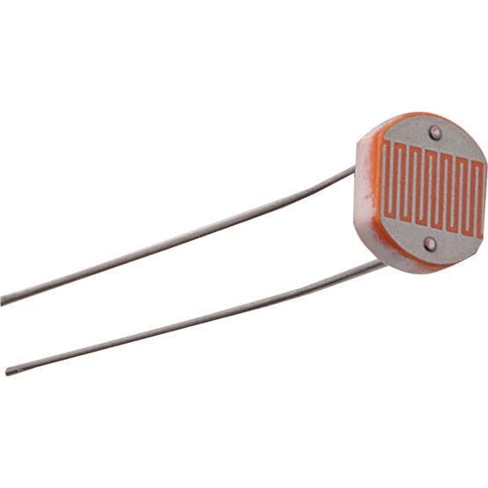
FEATURES
LDR 5mm
Sensor-controlled Switches
Temperature & Humidity Measurement
Automated Door Control
Fire & Gas Leak Alert
Theft Protection & Alert
Smartphone Connectivity

Slide 5
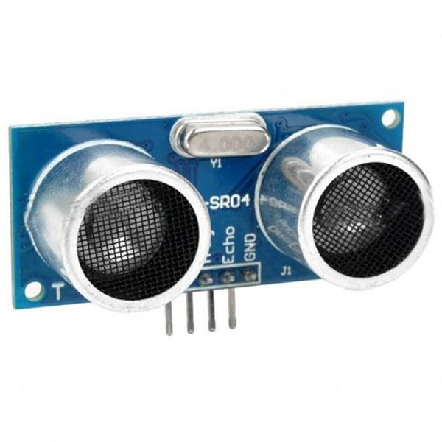
FEATURES
Sonar Sensor (HC-SR04)
Sensor-controlled Switches
Temperature & Humidity Measurement
Automated Door Control
Fire & Gas Leak Alert
Theft Protection & Alert
Smartphone Connectivity

Slide 6
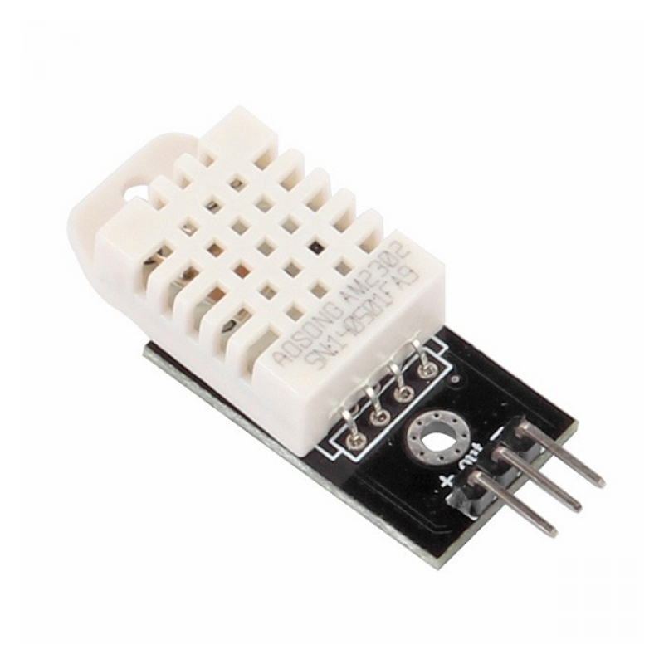
FEATURES
DHT22 Digital Temperature Humidity Sensor
Sensor-controlled Switches
Temperature & Humidity Measurement
Automated Door Control
Fire & Gas Leak Alert
Theft Protection & Alert
Smartphone Connectivity

Slide 7
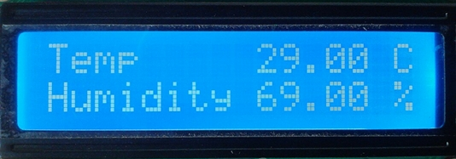
FEATURES
LCD Display 16X2
Sensor-controlled Switches
Temperature & Humidity Measurement
Automated Door Control
Fire & Gas Leak Alert
Theft Protection & Alert
Smartphone Connectivity

Slide 8

FEATURES
Servo Motor SG91R
Sensor-controlled Switches
Temperature & Humidity Measurement
Automated Door Control
Fire & Gas Leak Alert
Theft Protection & Alert
Smartphone Connectivity

Slide 9
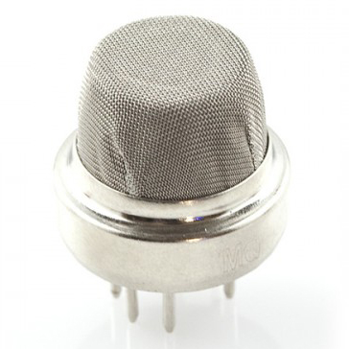
FEATURES
Smoke Sensor (MQ-6)
Sensor-controlled Switches
Temperature & Humidity Measurement
Automated Door Control
Fire & Gas Leak Alert
Theft Protection & Alert
Smartphone Connectivity

Slide 10
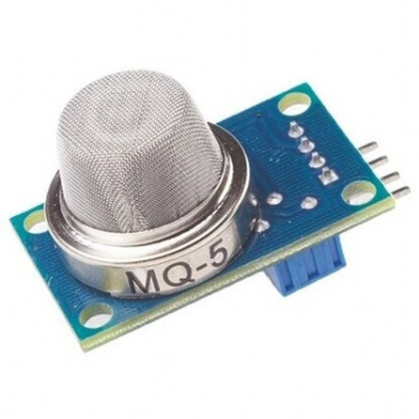
FEATURES
Gas Sensor Module (MQ-5)
Sensor-controlled Switches
Temperature & Humidity Measurement
Automated Door Control
Fire & Gas Leak Alert
Theft Protection & Alert
Smartphone Connectivity

Slide 11
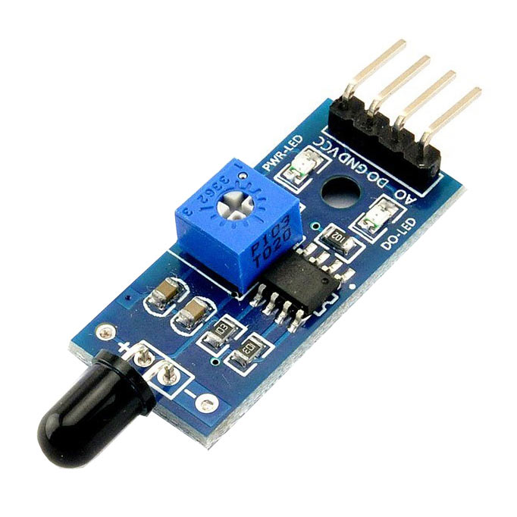
FEATURES
Flame Sensor
Sensor-controlled Switches
Temperature & Humidity Measurement
Automated Door Control
Fire & Gas Leak Alert
Theft Protection & Alert
Smartphone Connectivity

Slide 12
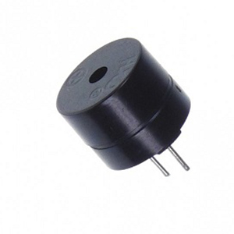
FEATURES
Buzzer
Sensor-controlled Switches
Temperature & Humidity Measurement
Automated Door Control
Fire & Gas Leak Alert
Theft Protection & Alert
Smartphone Connectivity

Slide 13
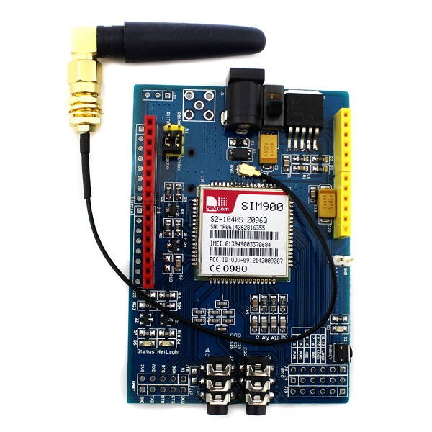
FEATURES
SIM900 GSM GPRS Shield
Sensor-controlled Switches
Temperature & Humidity Measurement
Automated Door Control
Fire & Gas Leak Alert
Theft Protection & Alert
Smartphone Connectivity

Slide 14
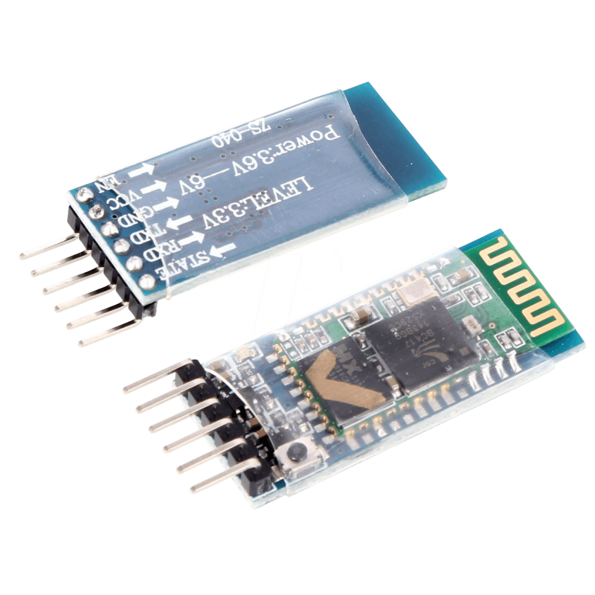
FEATURES
Arduino Bluetooth Module (HC-05)
Sensor-controlled Switches
Temperature & Humidity Measurement
Automated Door Control
Fire & Gas Leak Alert
Theft Protection & Alert
Smartphone Connectivity

Slide 15



FEATURES
Android App
Sensor-controlled Switches
Temperature & Humidity Measurement
Automated Door Control
Fire & Gas Leak Alert
Theft Protection & Alert
Smartphone Connectivity

Slide 16

Thank you!

